Slide 1


MEDITECH Expanse
Universal Discharge
Web Based EHR

Slide 2

Content
Only major sections indicated
Introduction
Universal Discharge InPt
Referrals
Prescriptions
ED Discharge
Slide 3
Slide 5
Slides 16-18
Slides 20-31
Slides 42-45

Slide 3
Universal Discharge
Overview
Meditech has adopted a Discharge Process with all-inclusive access
Providers have the most input, but
  Case Management and Nursing can add information
  Registration details are included
While we will demonstrate the “discharge” tab
  The same information is in discharge documents under the “Discharge Plan” section.

Slide 4
Universal Discharge
Types
At the time this was produced, there were 3 different Universal Discharges
The location of the patient determines which displays
  The current location each time “Discharge” is opened
ED (ED location)
  ED specific information
Post-Op (SDS location)
  Post-Op specific information
Everywhere Else
  General information **This is what will be used for this training**

Slide 5
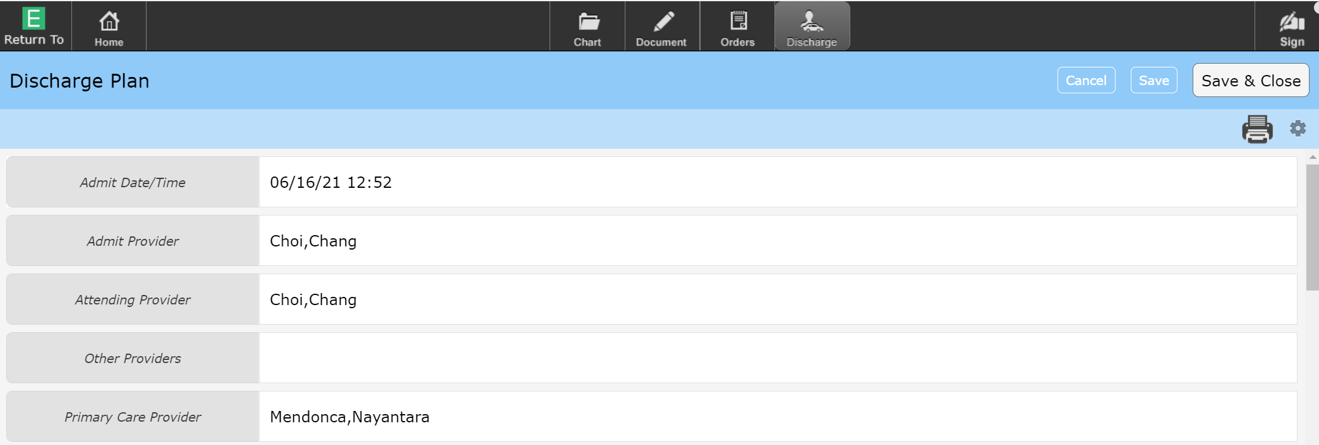
Universal Discharge
The Discharge screen
Registration information (grey indicates access to edit is restricted)
Option to Cancel or Save changes made
  Save & Close (Saves and returns to the chart)

Slide 6
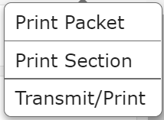
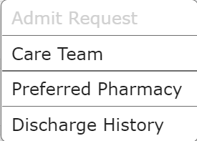
Universal Discharge
The Printer Icon
  Print Packet & Print Sections – Nurses print the Discharge Packet usually
  Transmit/Print – Reprint or Retransmit Prescriptions
Cogwheel
  Care Team (All Providers associated with Account)
  Preferred Pharmacy – Review/Edit Pharmacy to be used for eRx

Slide 7
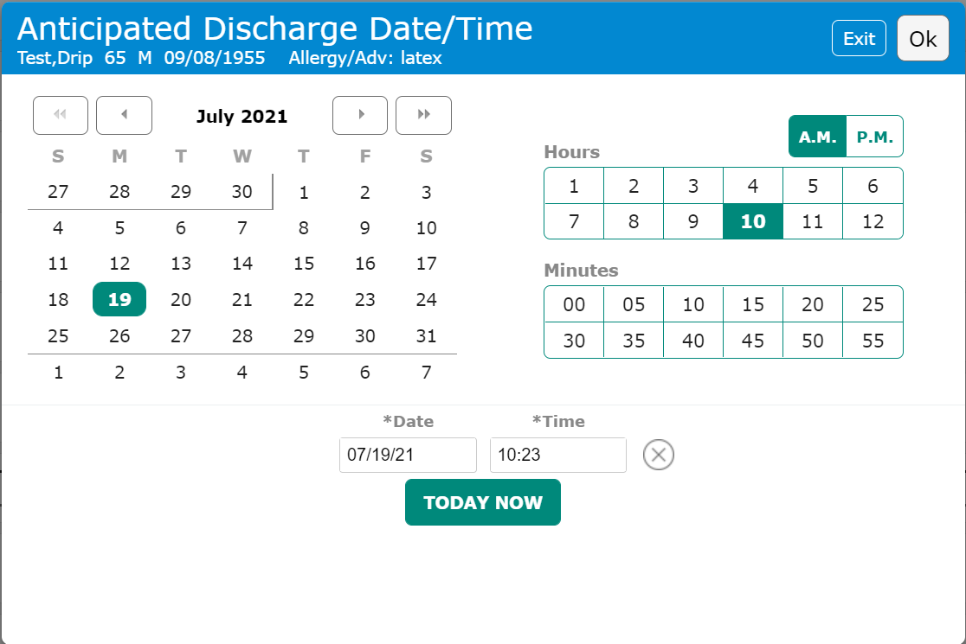
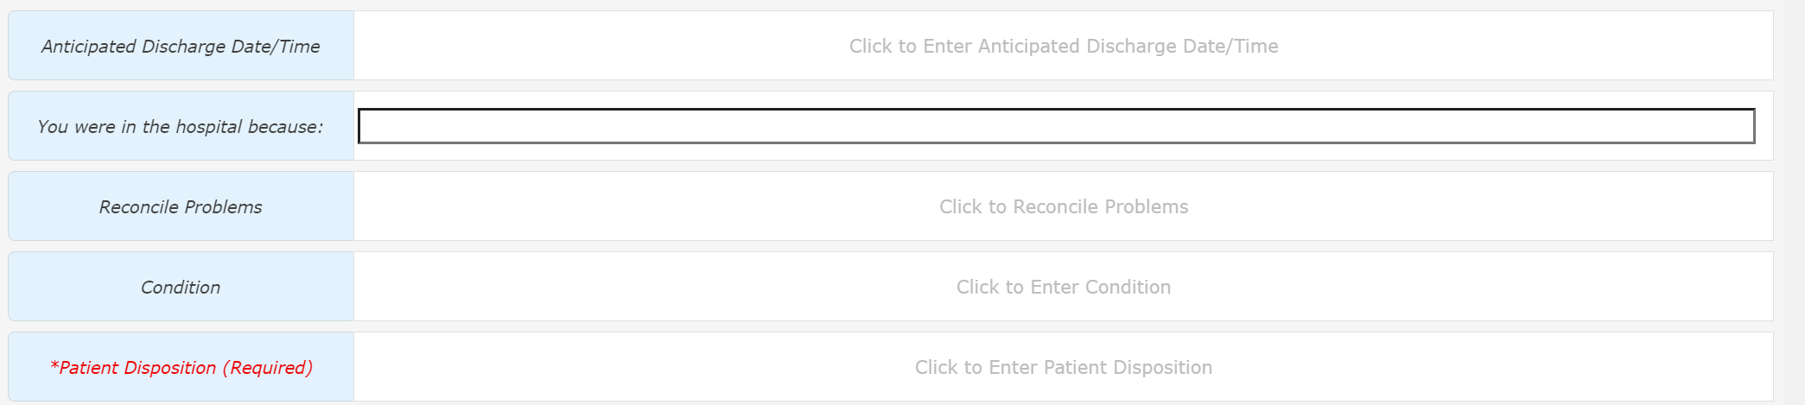
Universal Discharge
Anticipated Discharge Date/Time
Anticipated Discharge Date/Time
  Clicking anywhere within the highlighted are opens the Pop-Up
Click or type the Date and Time
  Not a 24 clock so AM/PM must be selected
“Today Now” button if preparing for imminent discharge

Slide 8

Universal Discharge
You were in the hospital because:
You were in the hospital because:
  Free text
No ICD-10 codes included in Discharge Packet
Enter reason in layman’s terms

Slide 9
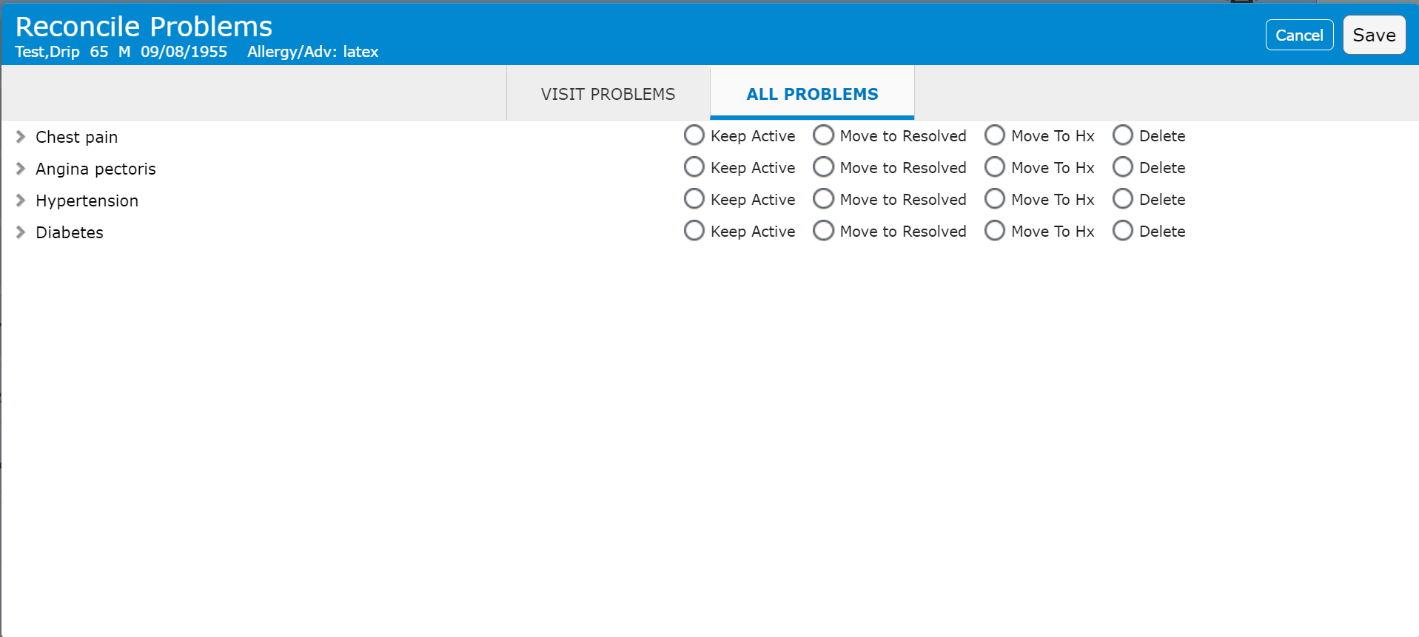
Universal Discharge
Reconcile Problems
Reconcile Problems
  Clicking anywhere within the highlighted are opens the Pop-Up
Visit/All – Defaults to “Visit”, “All” displays all Active Problems
Keep Active – Keeps problem in Active column (only recurring & chronic)
Move to Resolved – Resolved, non-chronic problems
Move to Hx – Chronic problems
Delete - Errors

Slide 10
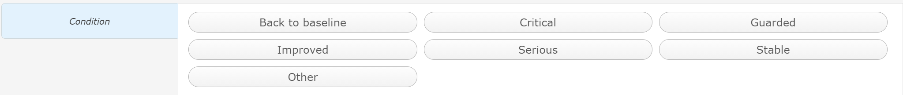
Universal Discharge
Condition
Condition
  Clicking anywhere within the highlighted are opens the Pop-Up
Select Discharge Condition

Slide 11
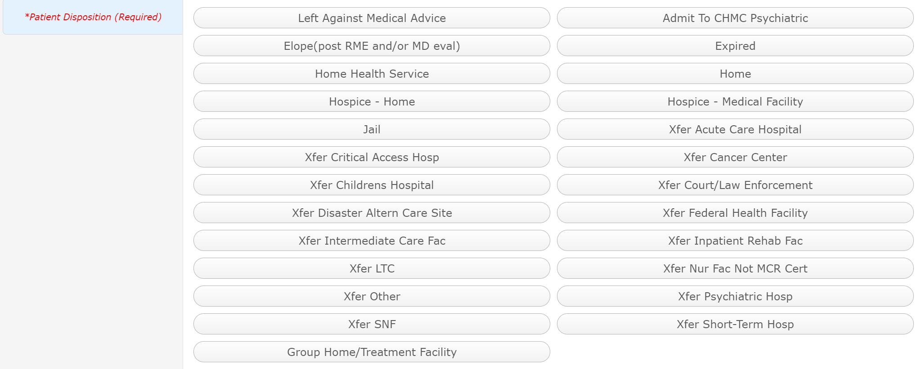
Universal Discharge
*Patient Disposition
Patient Disposition
  Clicking anywhere within the highlighted are opens the Pop-Up
Select appropriate disposition

Slide 12
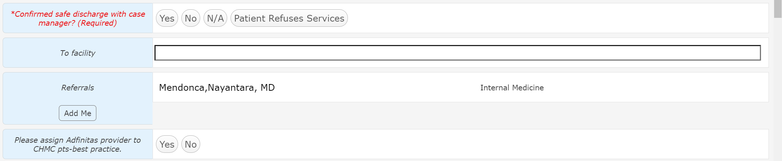
Universal Discharge
*Confirmed safe discharge with case manager
*Confirmed safe discharge with case manager
Select appropriate answer
  This is a safety question to determine if you Case Management has been consulted with and agreed to the discharge
  N/A – if it doesn’t apply
  Patient Refuses Services – If patient is uncooperative with plan

Slide 13
Universal Discharge
To facility
To facility
Free text
  Nursing home or Rehabilitation facility
  Not a transfer?

Slide 14
Universal Discharge
Referrals
Referrals
Control who the patient will follow-up with
Click to Edit the PHP referral
Click to Add or Edit Referrals
Click to add yourself as Referral (Consultants)

Slide 15
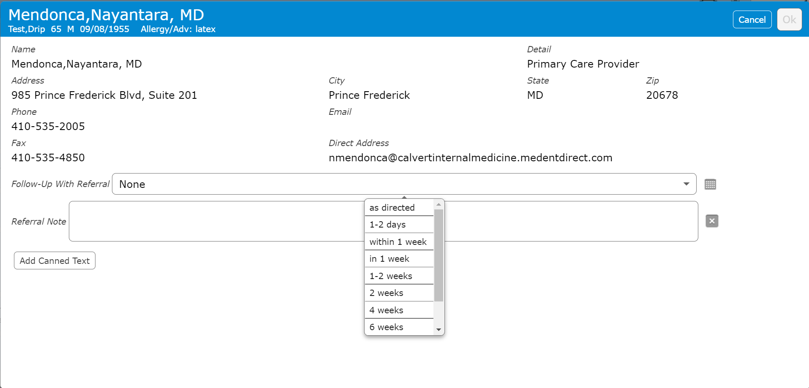
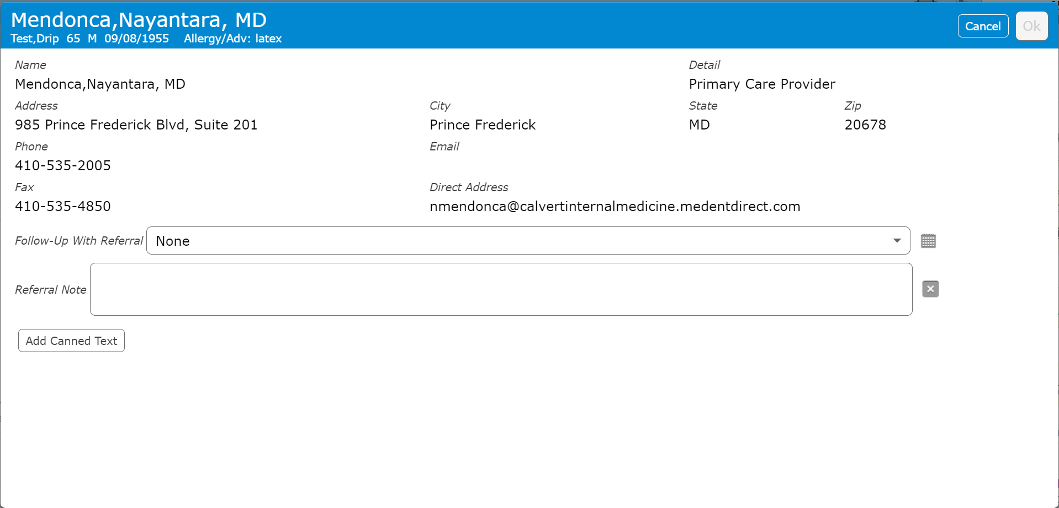
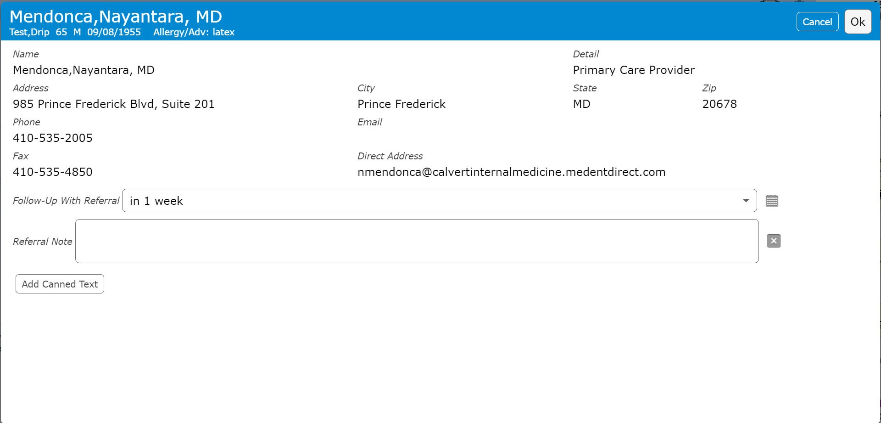
Universal Discharge
Referrals
PHP Referral
  Click to edit
Follow-Up time
  Select time frame, or “As directed
Referral Note – Free text
  Additional instructions

Slide 16
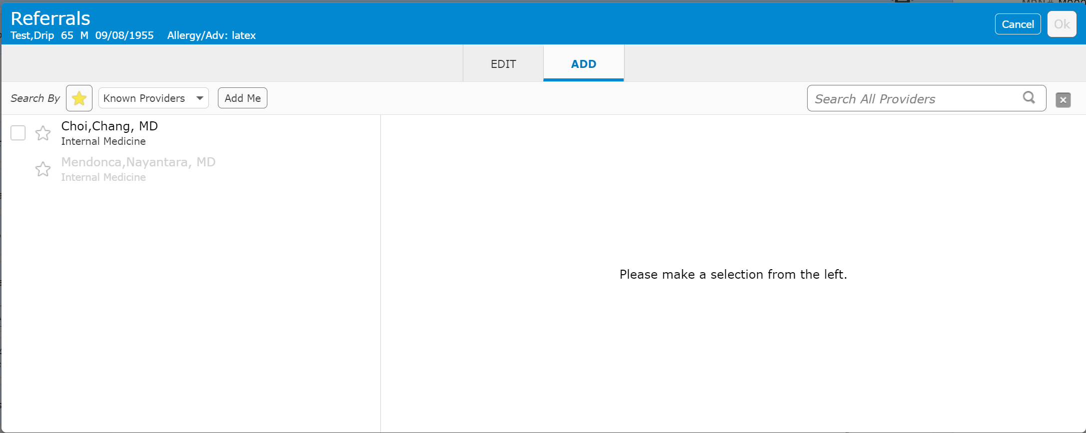
Universal Discharge
Referrals
Referrals – Add Referral
Existing PHP and Admitting providers display (Also Favorites)
2nd “Add Me” button

Slide 17
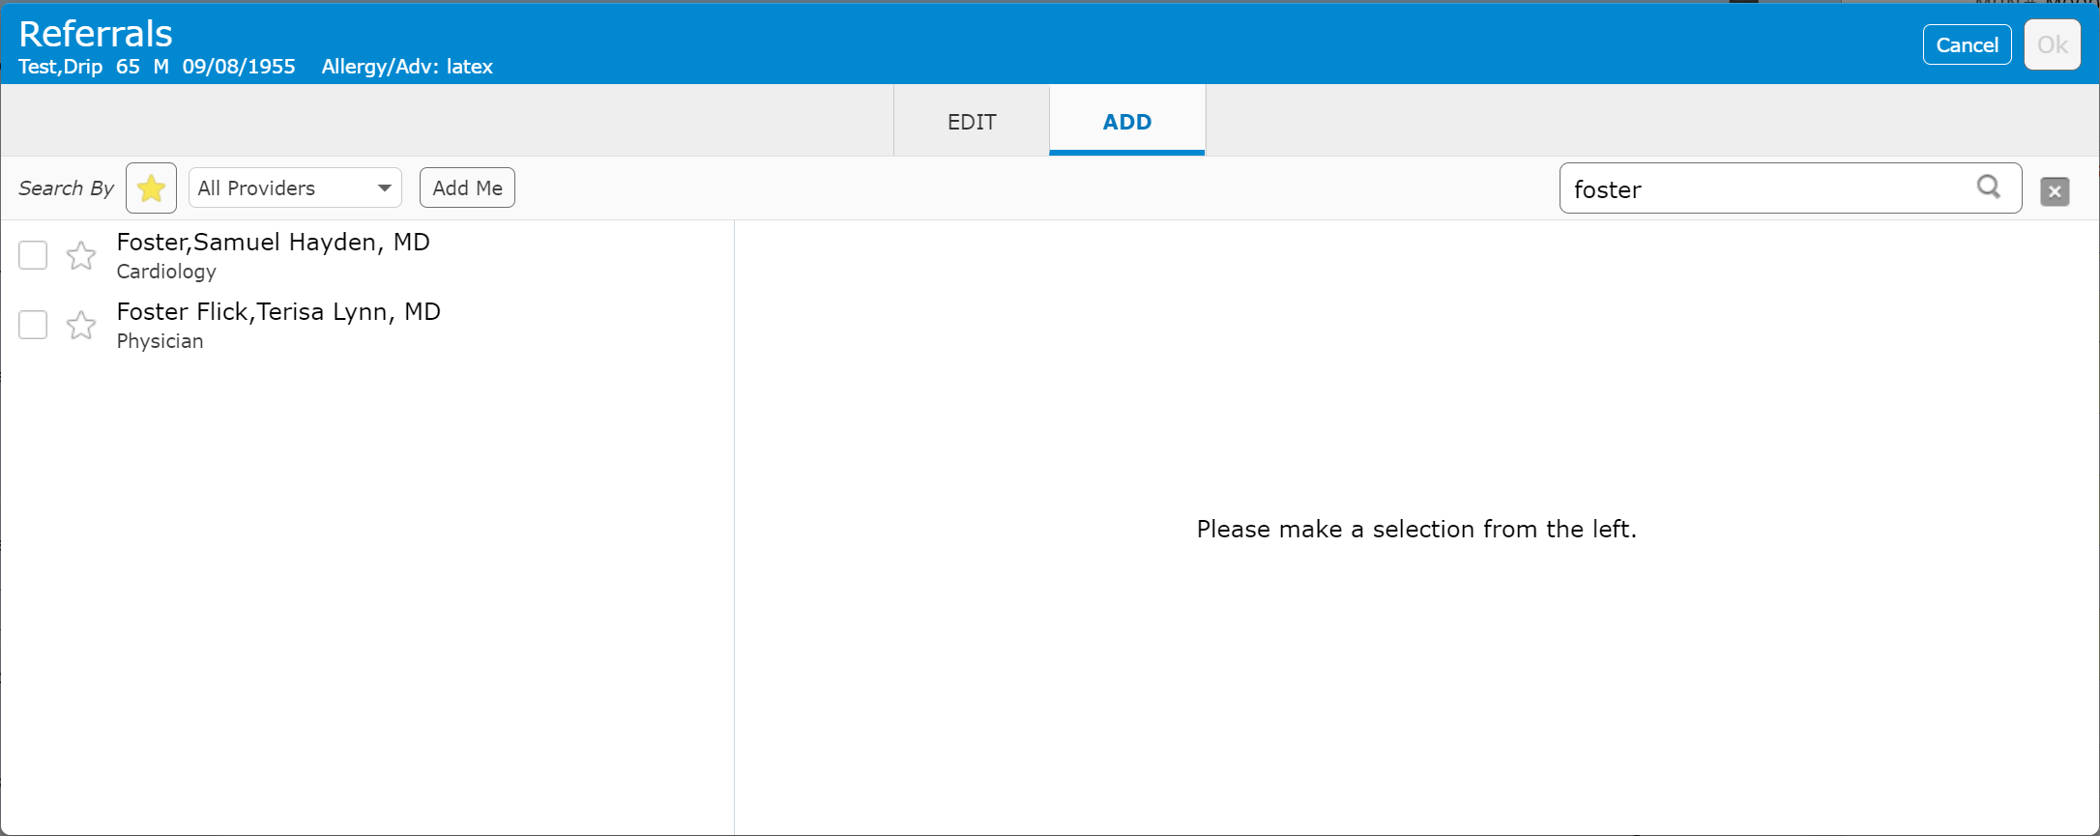
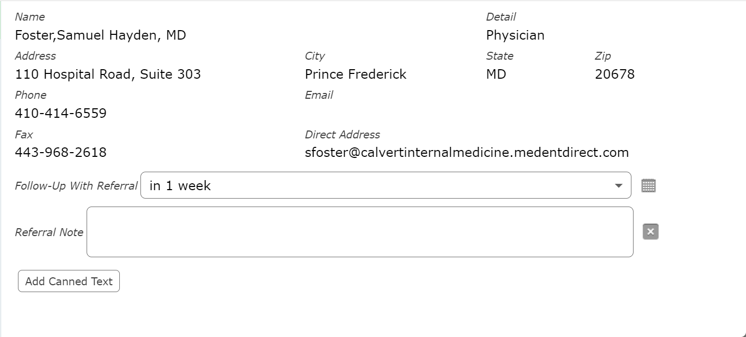
Universal Discharge
Referrals
Searching for provider
Click on box to select (Add details as shown for PHP)
Click on star to save as a favorite

Slide 18
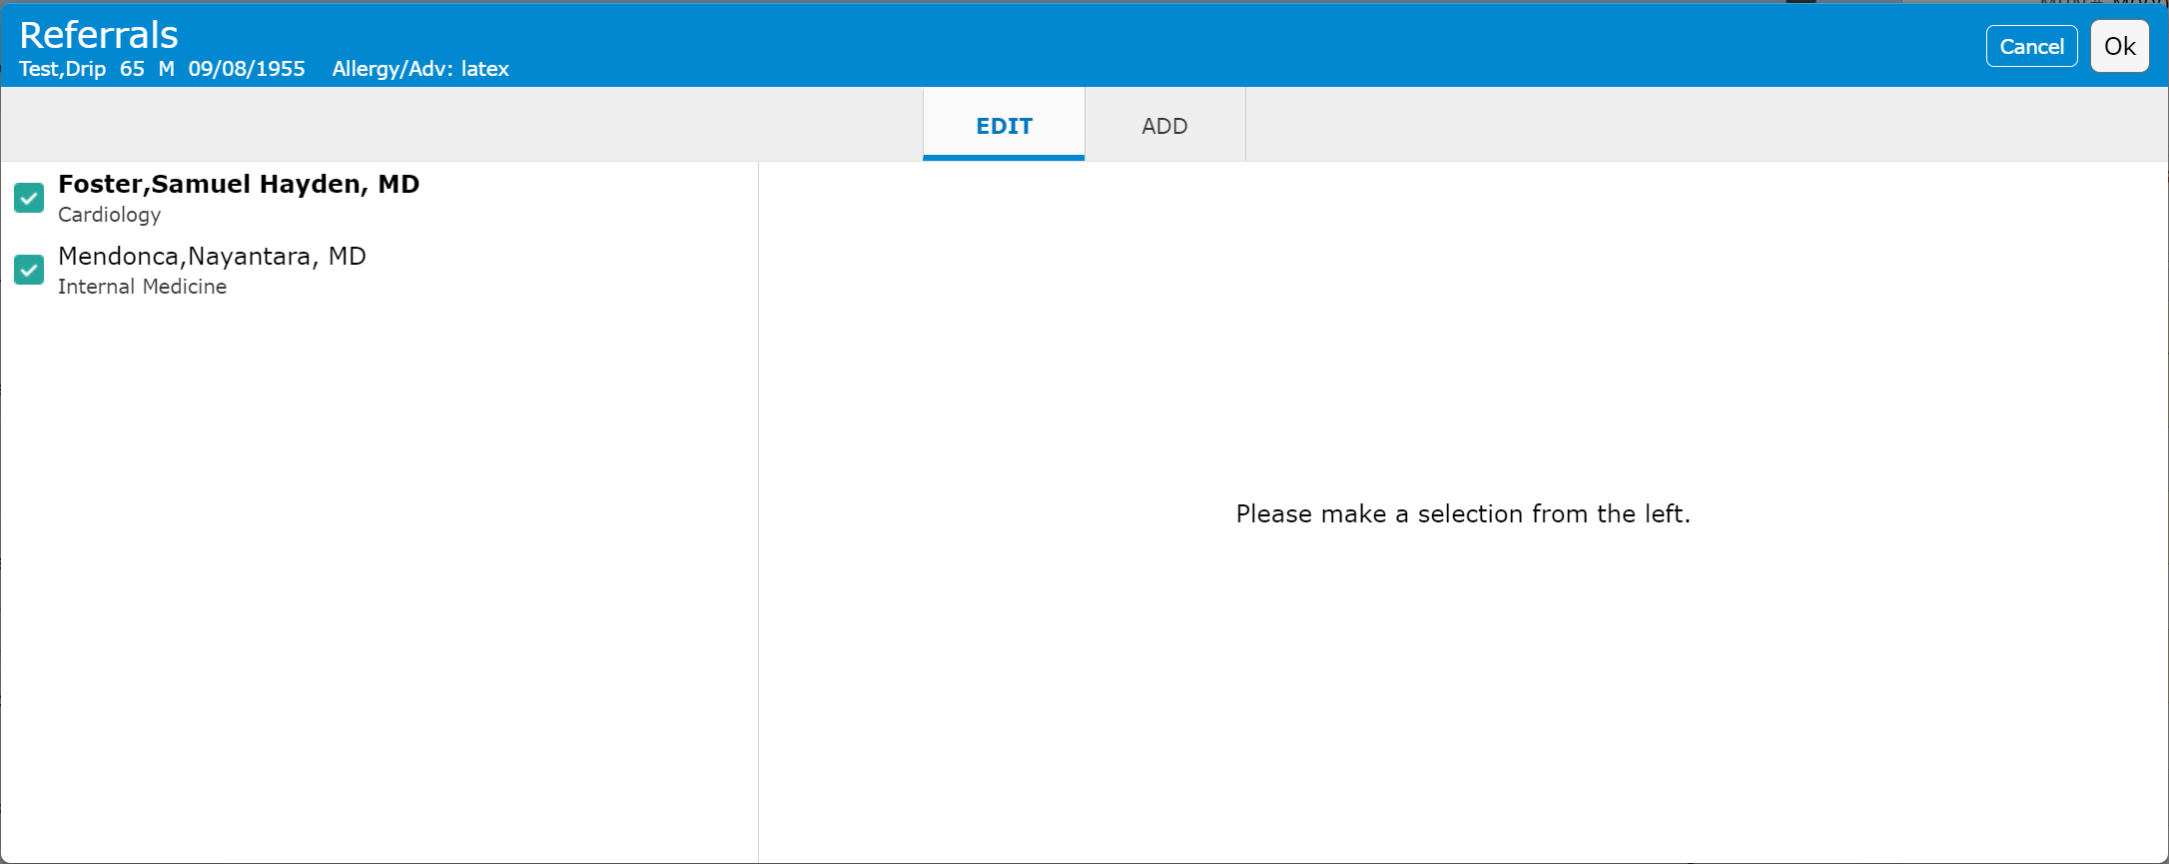
Universal Discharge
Referrals
Edit Referrals
  Click “Edit”
Click to uncheck box – Deselects referral

Slide 19
Universal Discharge
Adfinitas Question
Adfinitas question
Hospitalist specific question
  Ignore unless you are a hospitalist

Slide 20
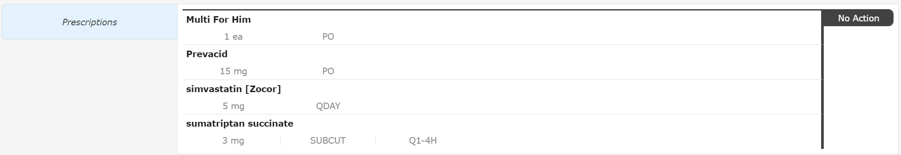
Universal Discharge
Prescriptions
Discharge Medication Reconciliation & Prescriptions
  Click in either area to open Discharge Med Rec Screen

Slide 21
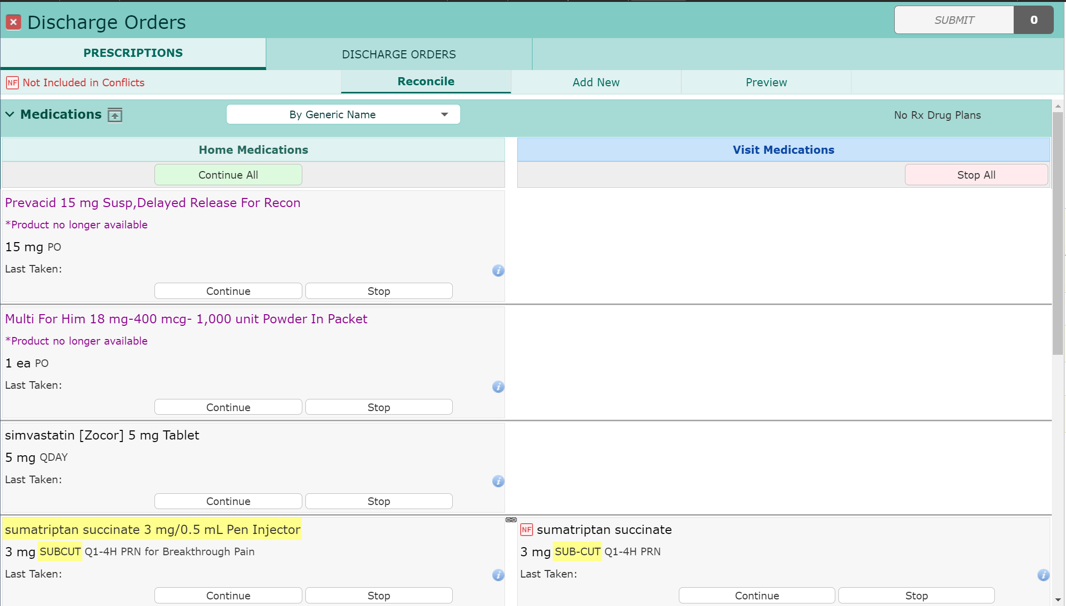
Universal Discharge
Prescriptions
Home medications
  Continue or Stop individual Meds
  Continue All
  Linked Medications
    Will “Stop” on Visit Side automatically

Slide 22
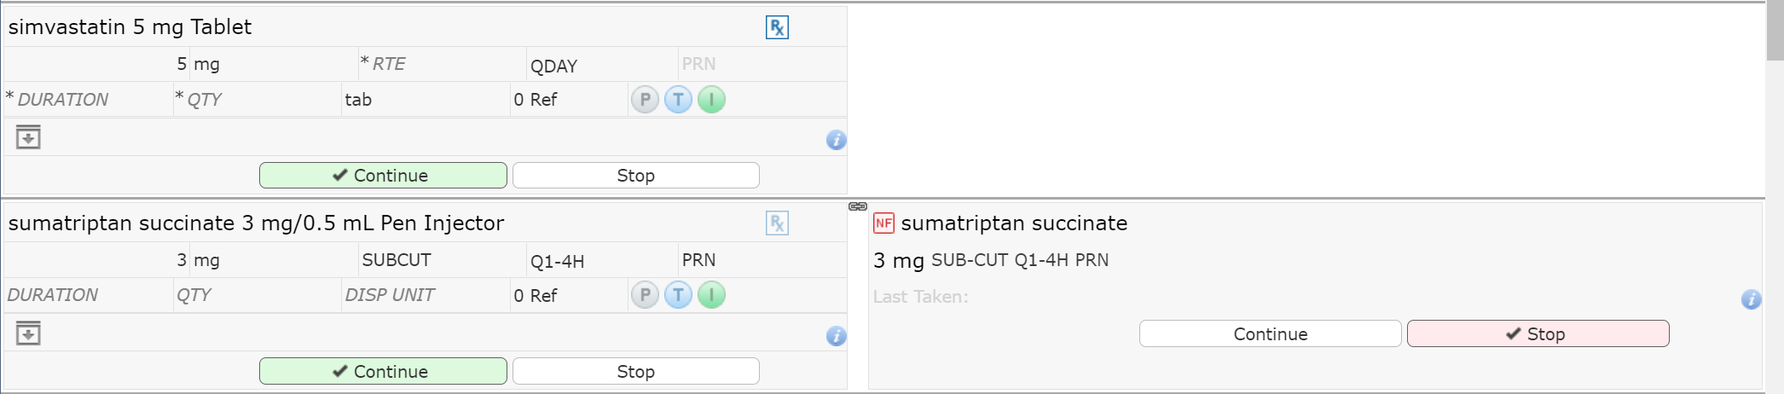
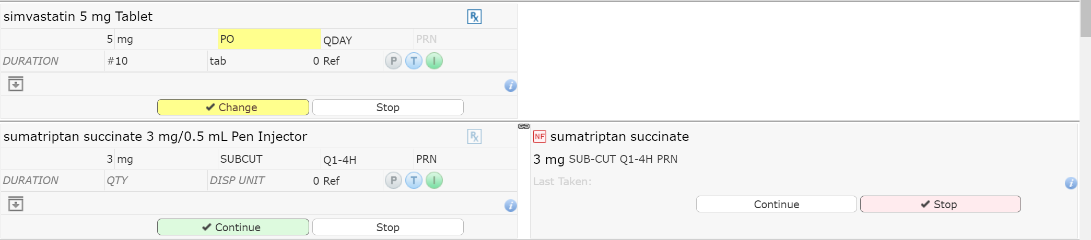
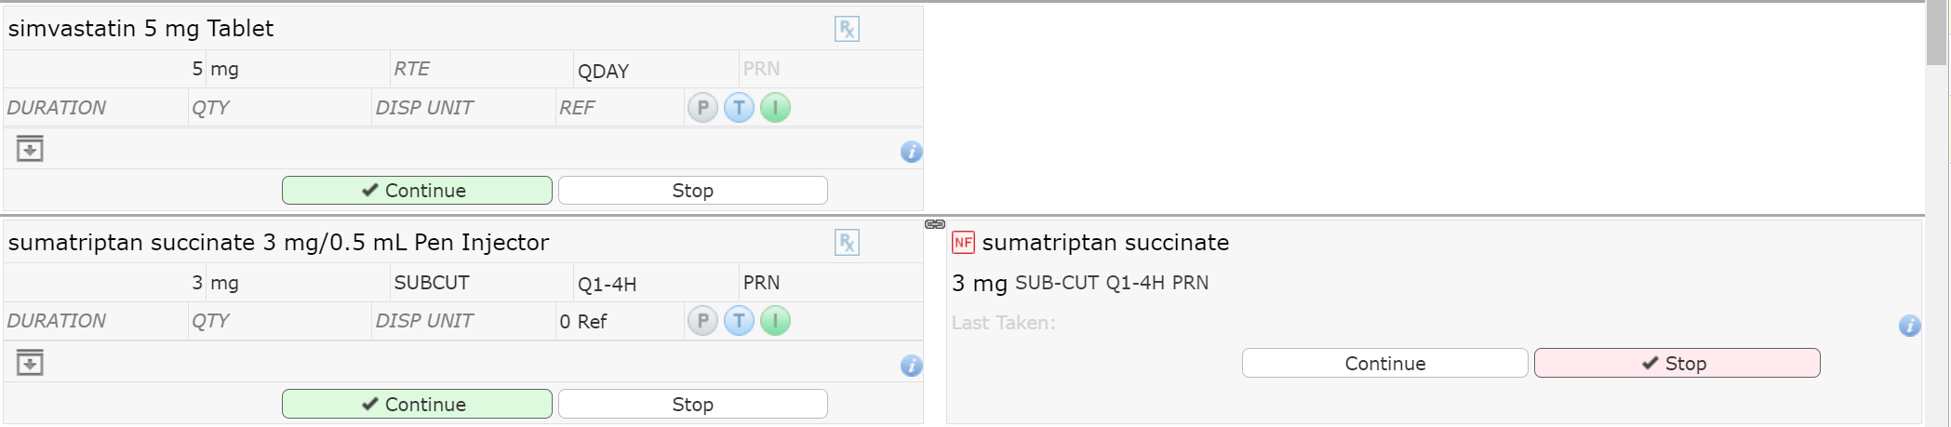
Universal Discharge
Prescriptions
Continued Home Medications
Click “Rx” symbol to create a prescription
  i.e. patient is out of medication
Duration/QTY
  Always enter QTY
PRN – Click to make prn (PRN reason required if selected)
RTE – Enter any additional required information (Route in this case)

Slide 23
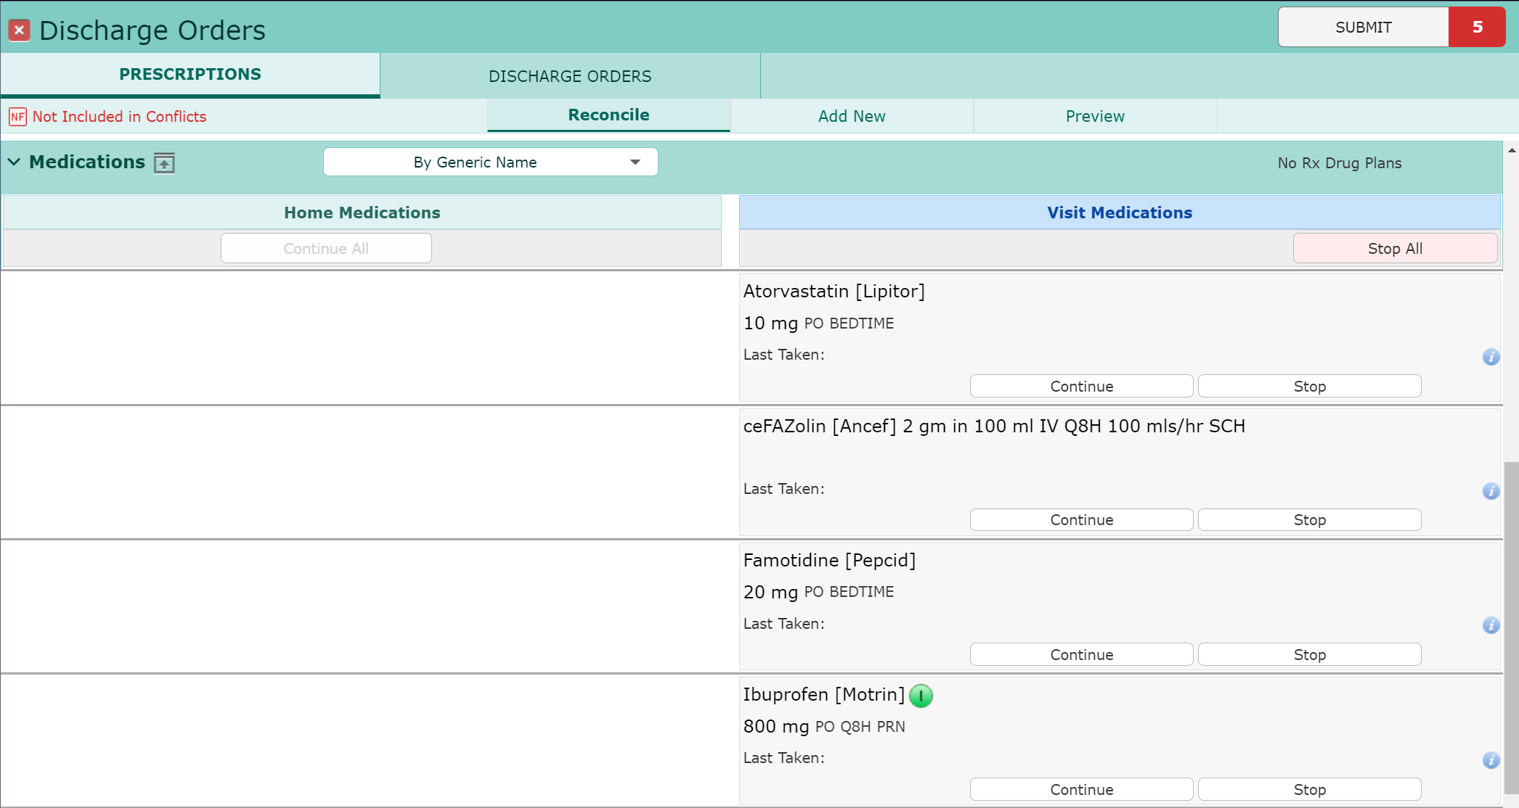
Universal Discharge
Prescriptions
Visit Medications
  Continue or Stop individual Meds
  Stop All

Slide 24
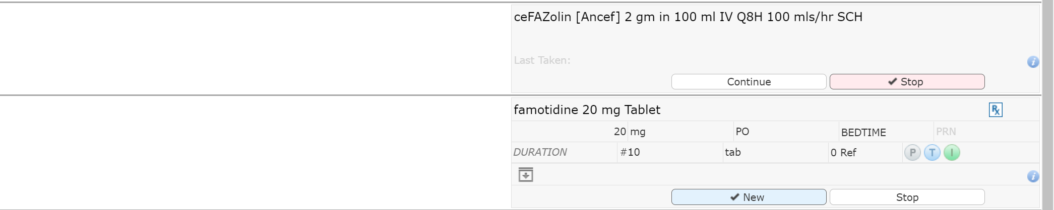
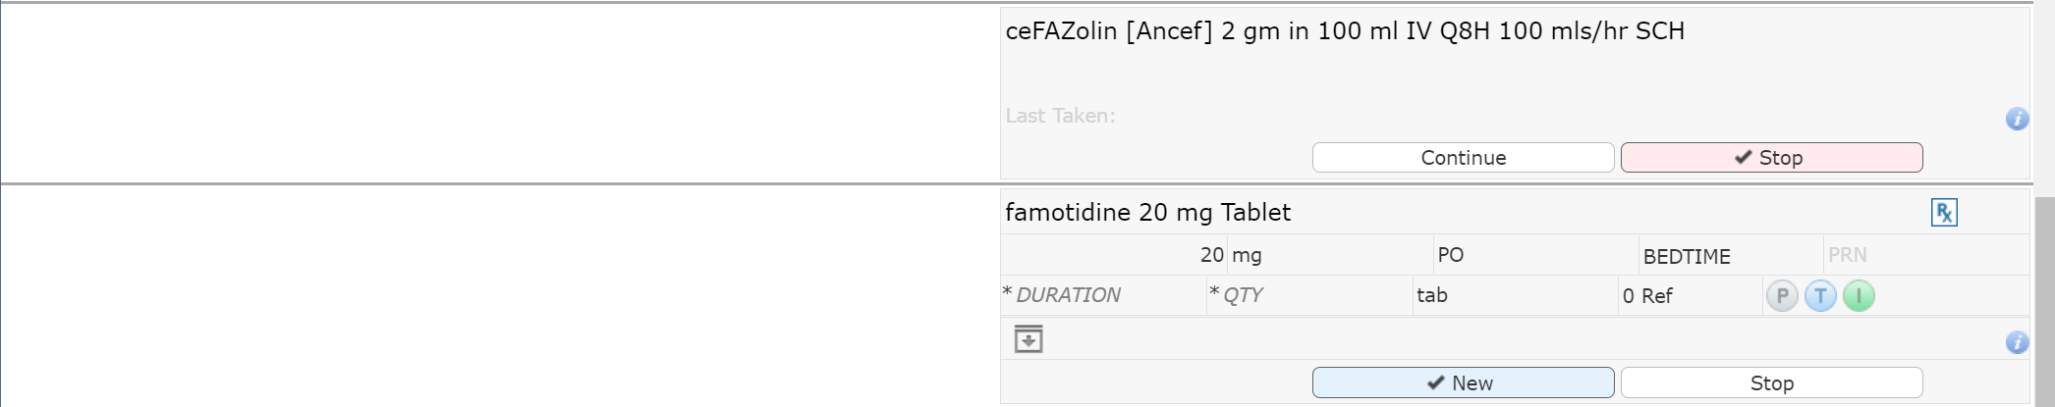
Universal Discharge
Prescriptions
Continuing a Visit Med
  Converts to “New”
  Becomes a Prescription
The same required and optional fields

Slide 25
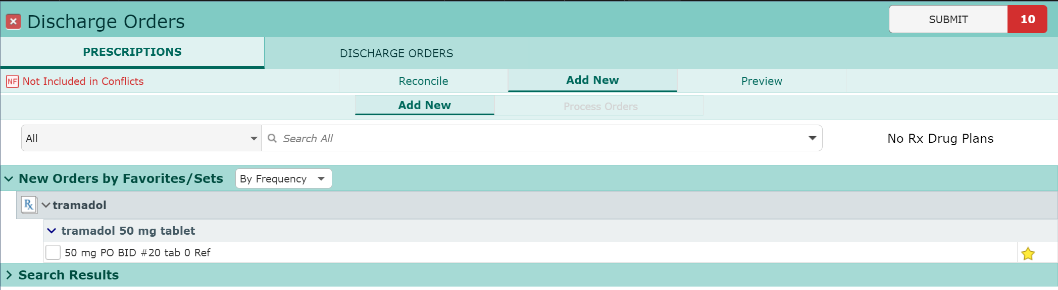
Universal Discharge
Prescriptions
New Prescriptions
  Click “Add New”
  Search for Rx Medication
  Favorite medications display

Slide 26
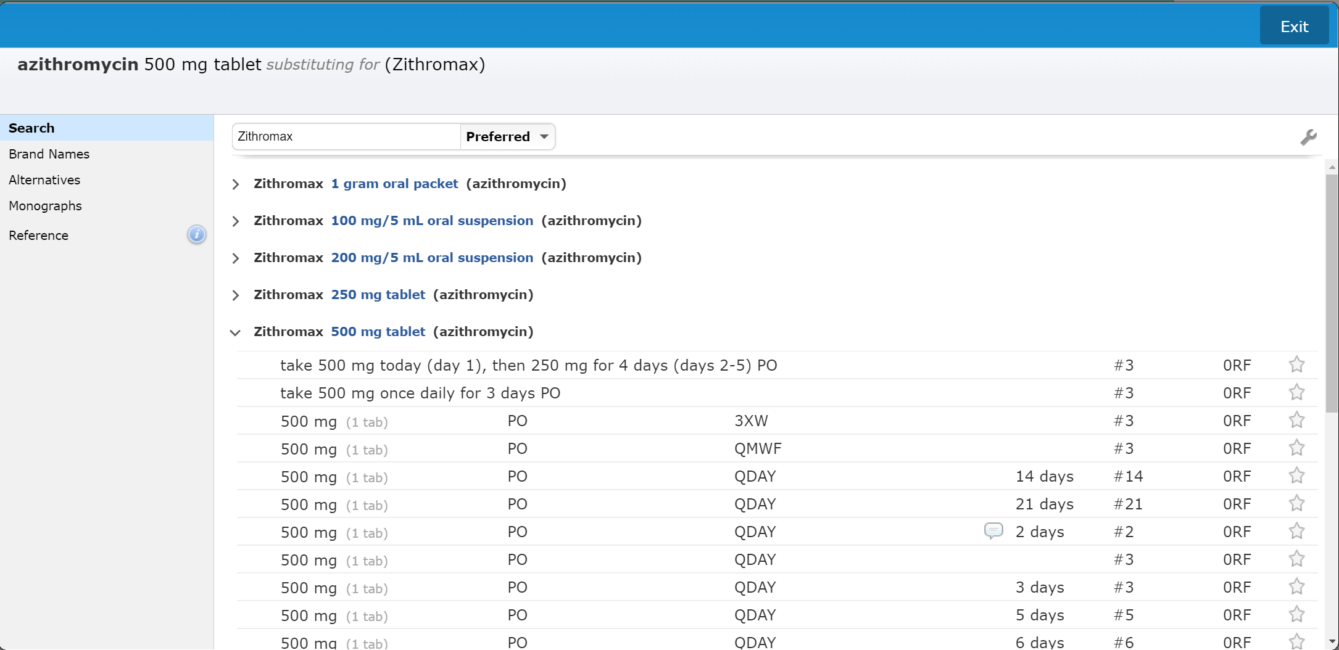
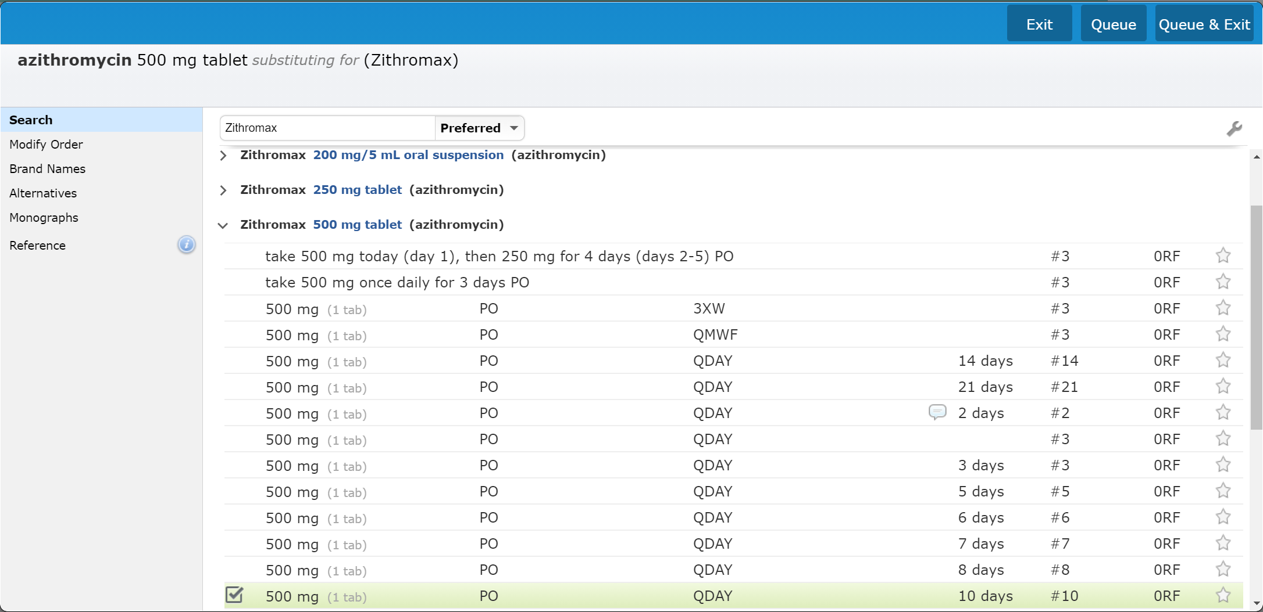
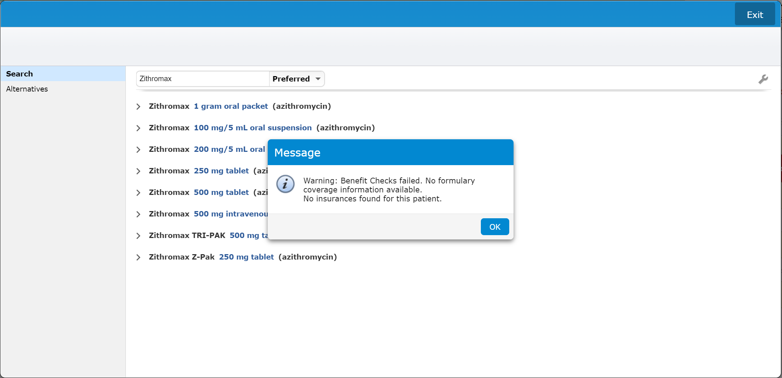
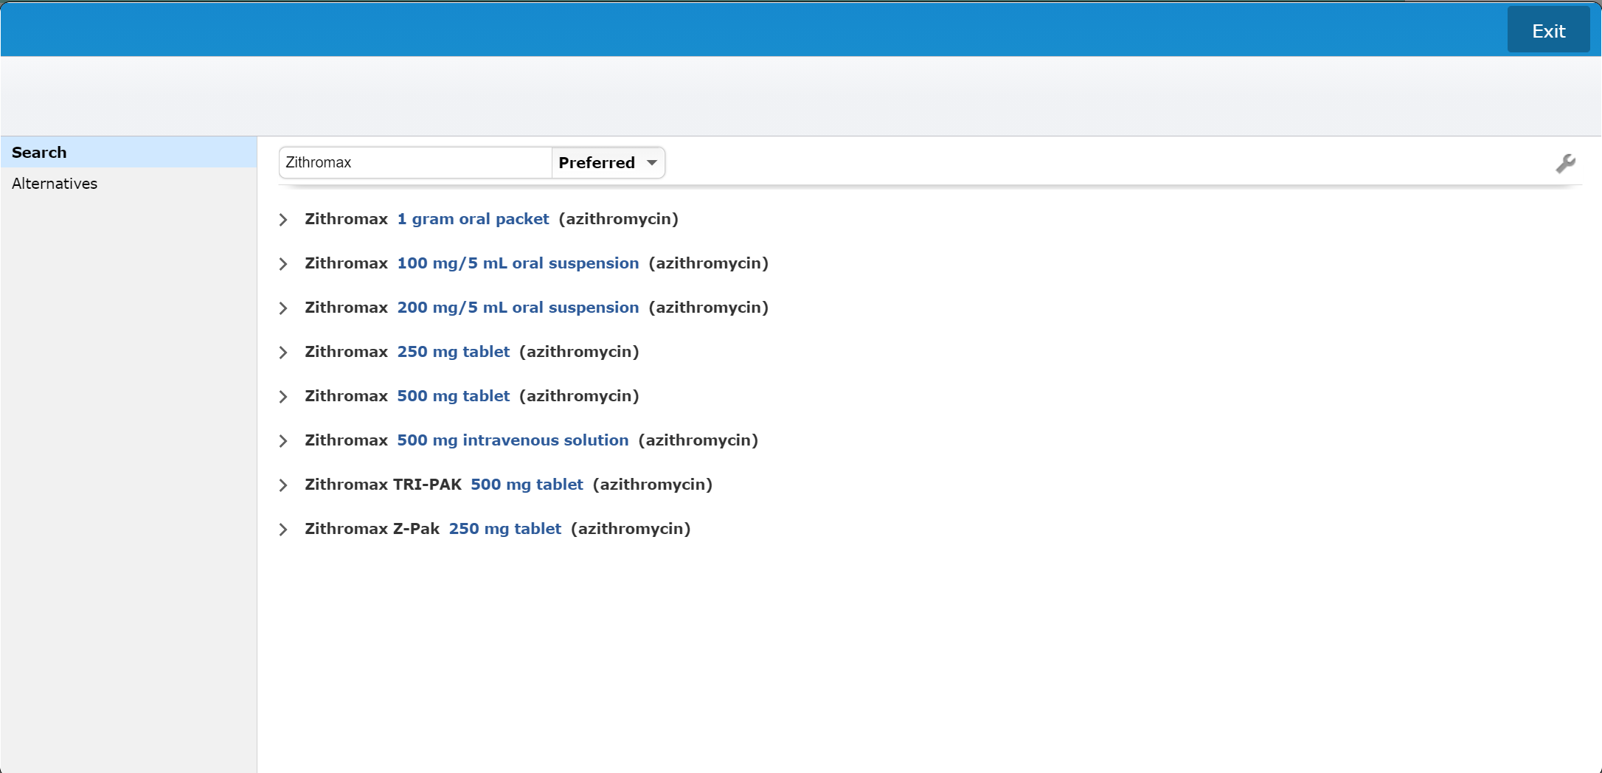
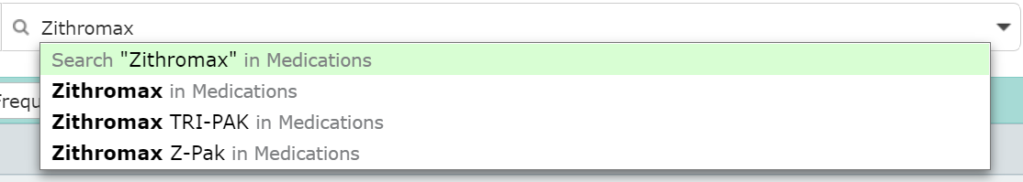
Universal Discharge
Prescriptions
Searching for new medication
  Select desired medication
Select the desired string (frequency/Duration)
Note that you can save as Favorite
Select the desire formulation
Selected string highlights in green
  Click to Edit Rx
Queue & Exit if done
Queue if adding additional Rx’s
Exit if you want to cancel adding a RX
Pop-Up about Insurance recommendations – Click “OK”

Slide 27
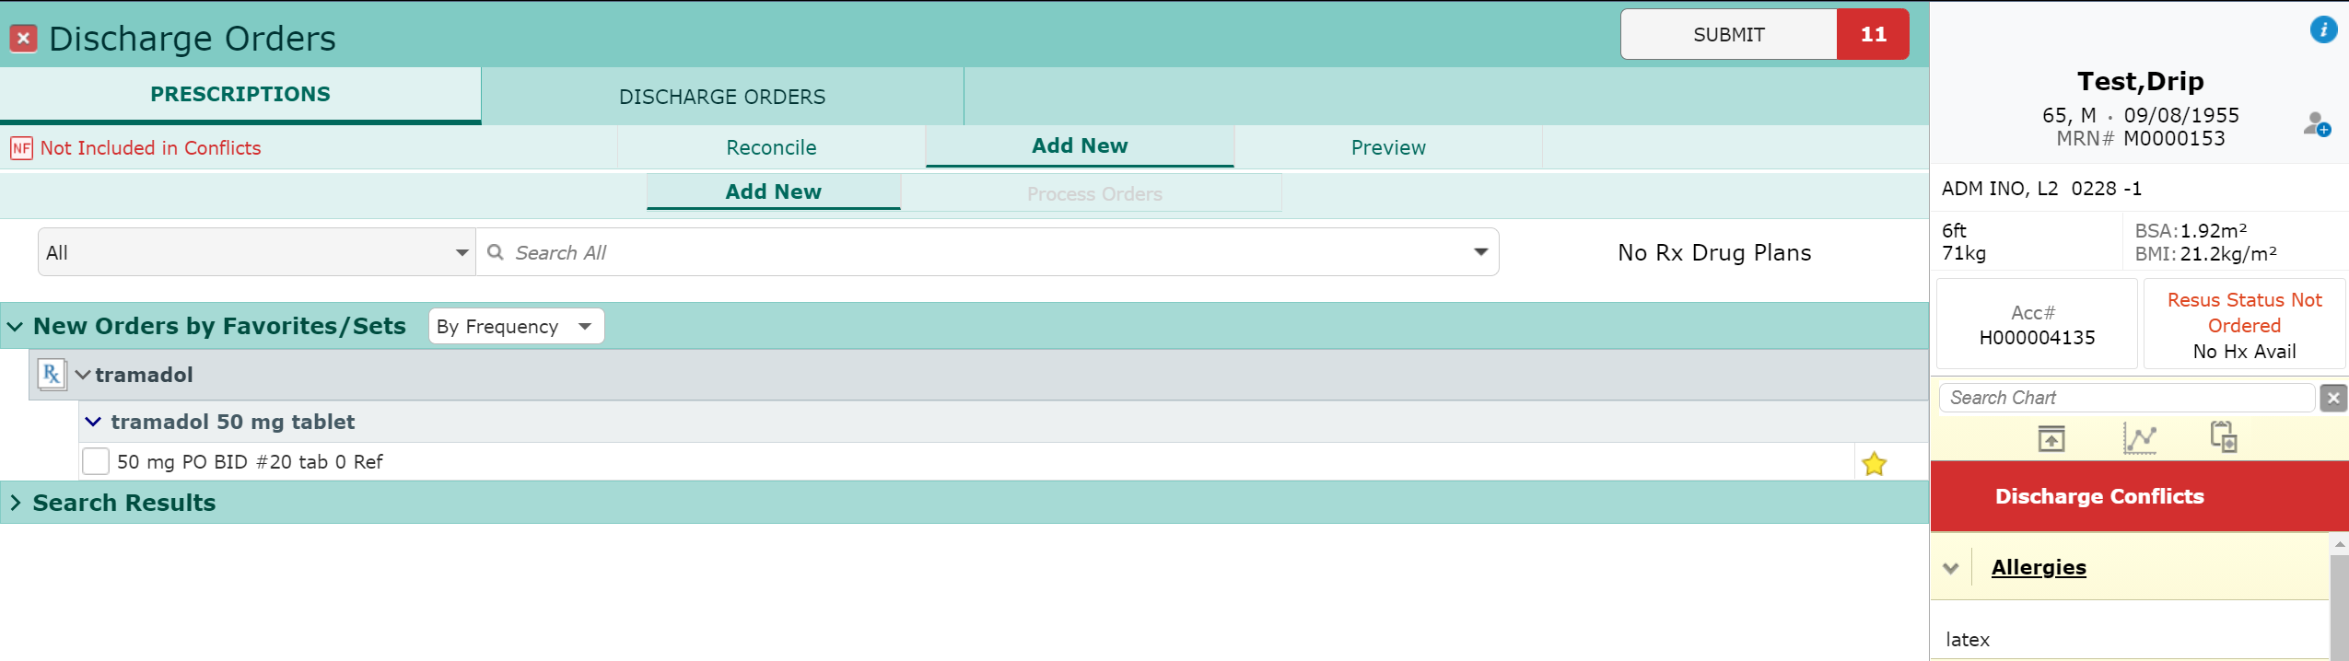
Universal Discharge
Prescriptions
Finalizing the Discharge Med Rec
  Conflicts are indicated
  Click “Submit” to finish

Slide 28
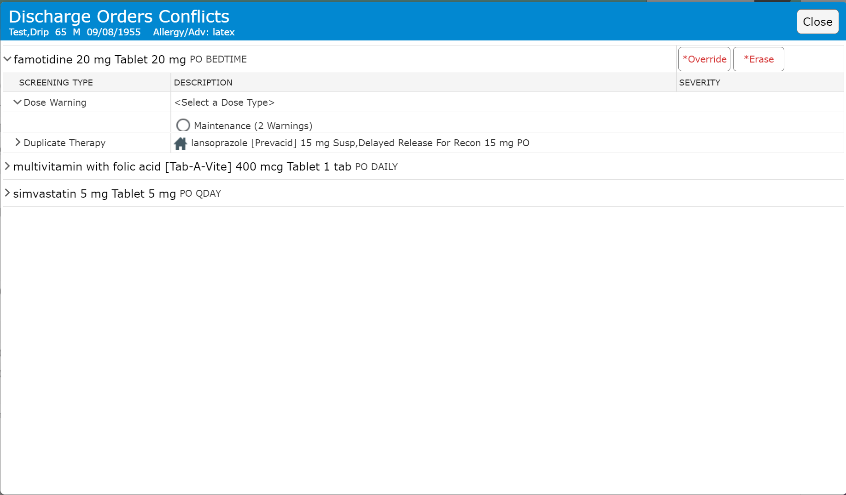
Universal Discharge
Prescriptions
Conflicts
  Pop-up one at a time
  Override (may require a reason)
  Erase (to remove med)

Slide 29
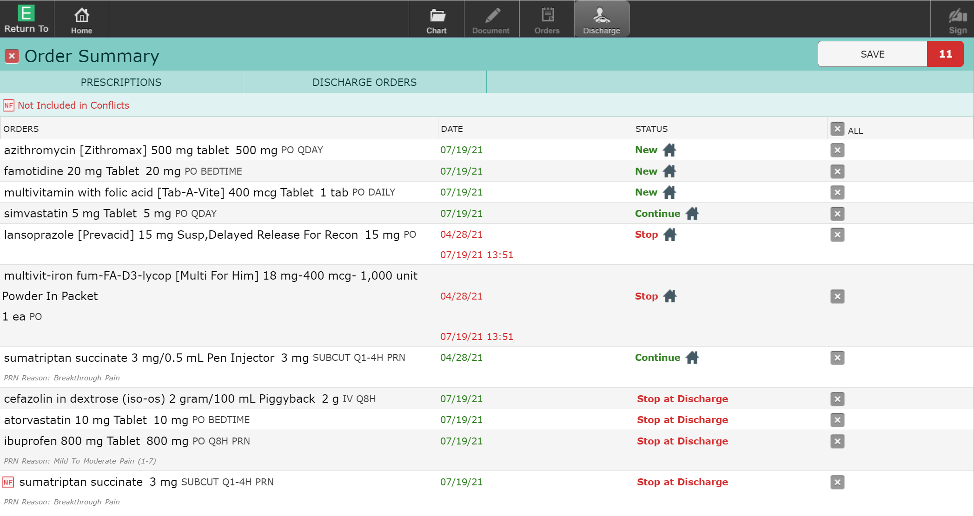
Universal Discharge
Prescriptions
“Save” & PIN to complete process
  Transmit/Print for Rx
Cancel if you change your mind
  Becomes unreconciled

Slide 30
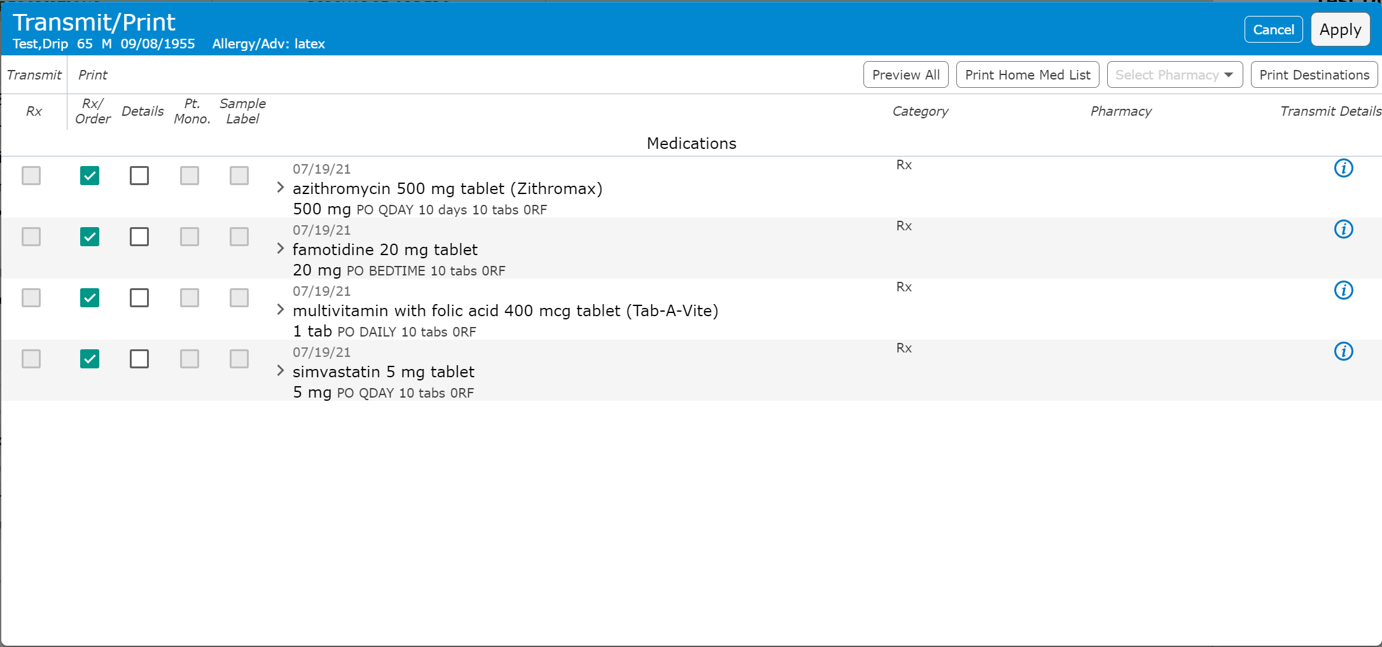
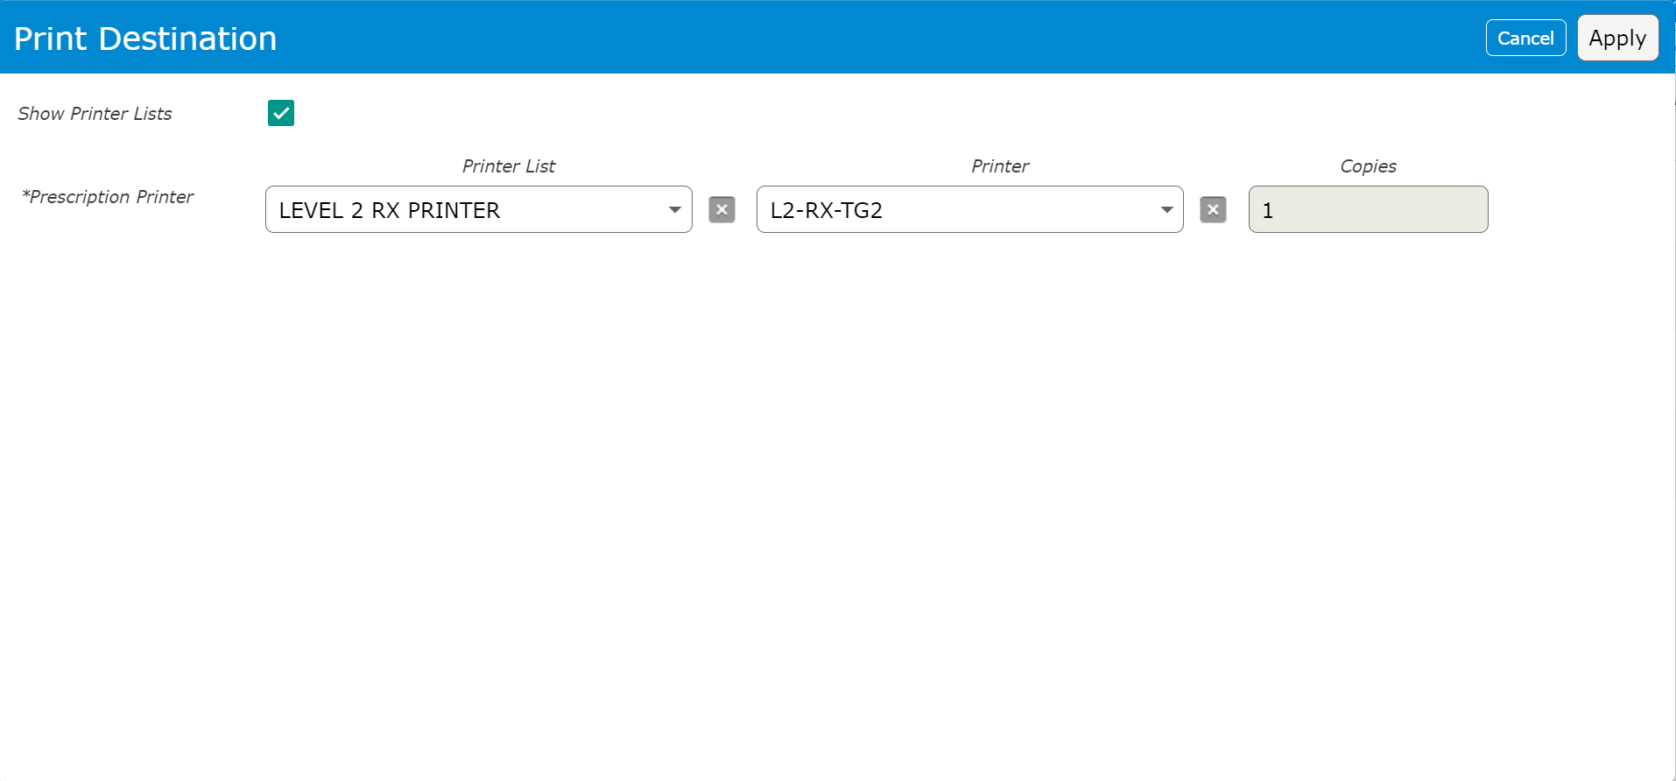
Universal Discharge
Prescriptions
Transmit/Print screen
  Print option
    May default – depends on setup (eRx)
    All options only show if no box is checked for Med
  Transmit option
    eRx must be setup to work
    Preferred Pharmacy must be entered to work
    Change Pharmacy
  Confirm Printer
  All Prescription Printers
    List option
  Unit and “TG”
    In name of Rx printer

Slide 31
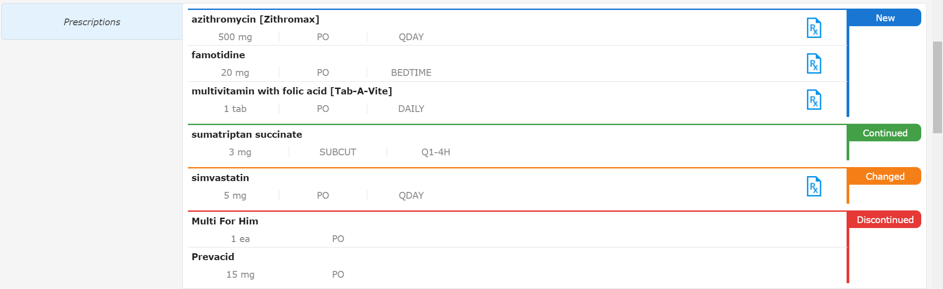
Universal Discharge
Prescriptions
Final display of Prescriptions

Slide 32
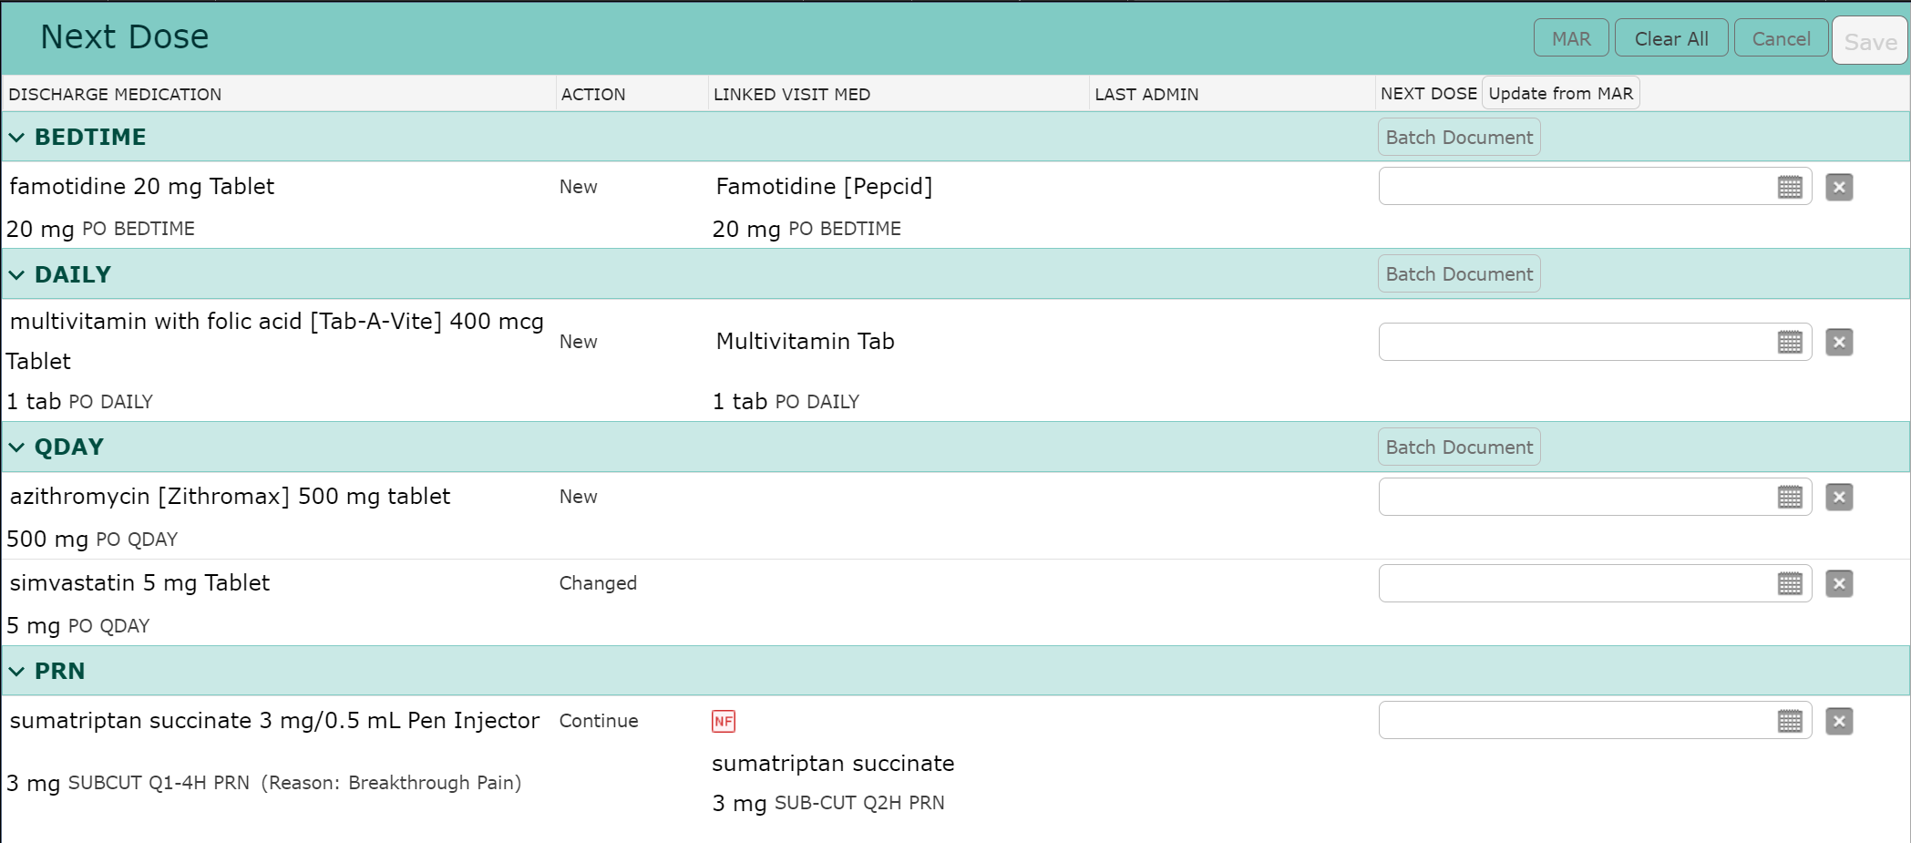
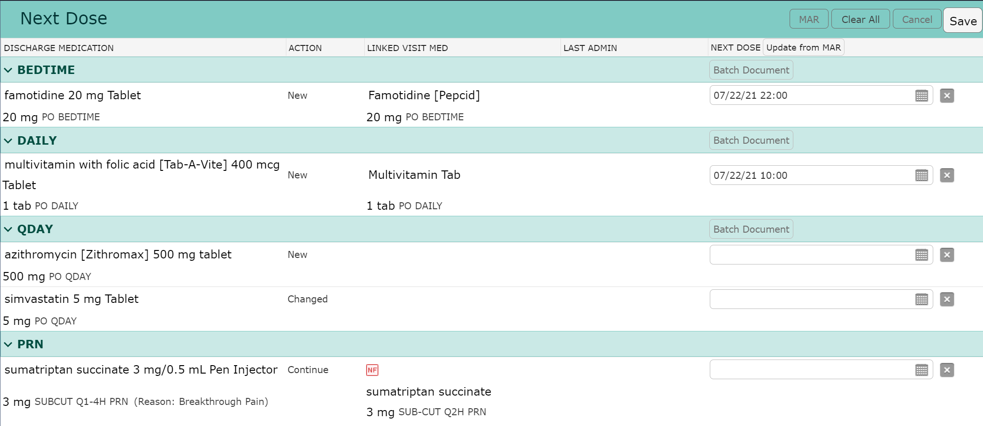
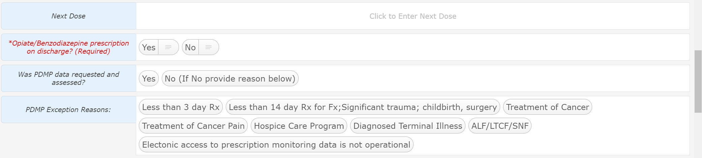
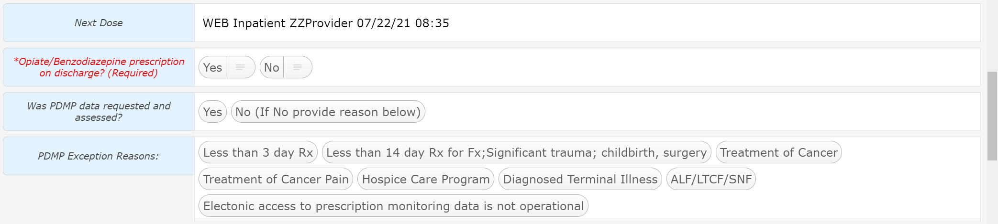
Universal Discharge
Next Dose
Next Dose
Simply Click the NEXT DOSE “Update from MAR” button
The last previous administration date & time is applied
Click “Save”

Slide 33
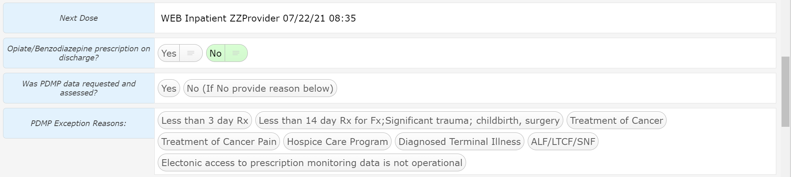
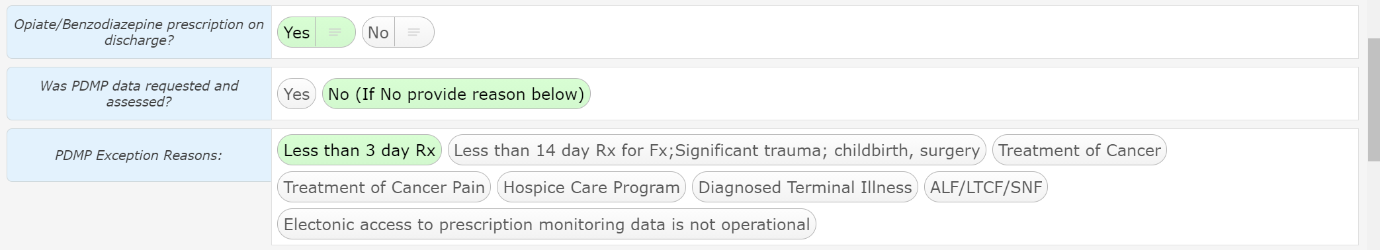
Universal Discharge
CRISP Questions
CRISP Questions
Required Yes or No, Were Opiate/Benzodiazepines prescribed on Discharge?
  If Yes, The next question will become required in the future
Was CRISP accessed and the data reviewed?
  If No, The next question will become required in the future
Exception reason
In our scenario, Opiates/Benzodiazepines were not prescribed
This example is provided for when CRISP was not consulted after Opiate/Benzodiazepine was ordered on discharge

Slide 34
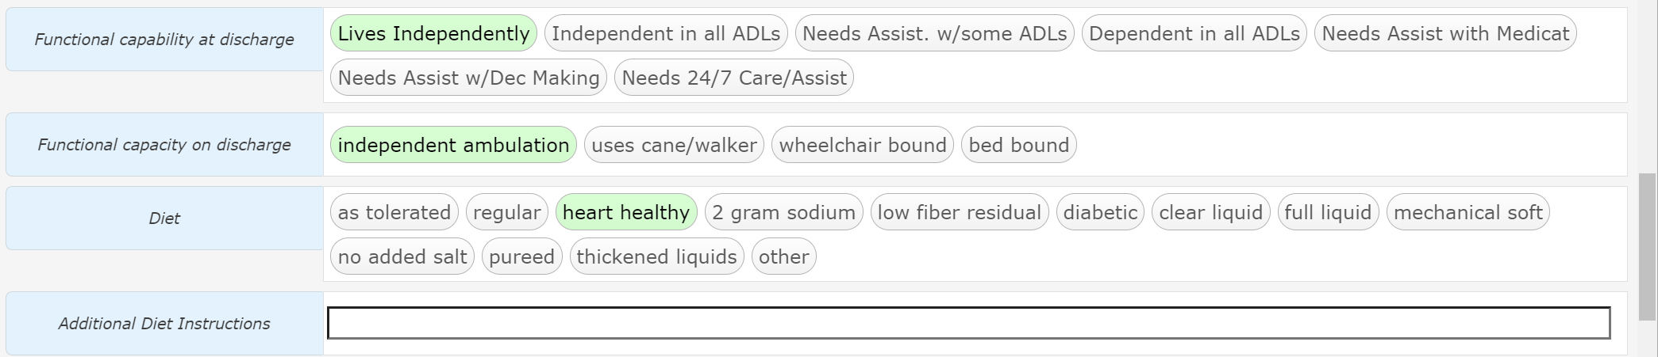
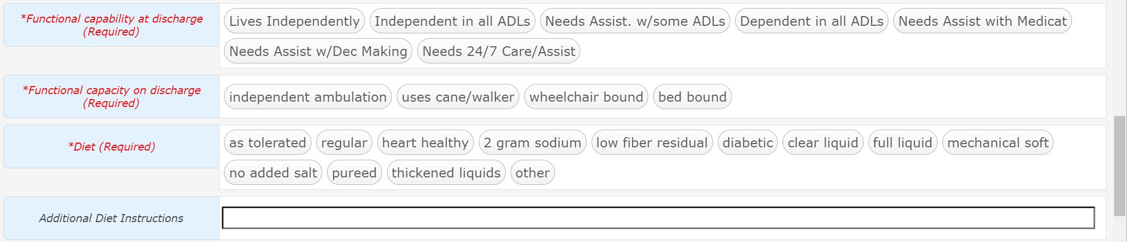
Universal Discharge
Required Section
These three questions are required
  Functional capability
  Functional capacity
  Diet
  Free text Additional Diet instructions

Slide 35
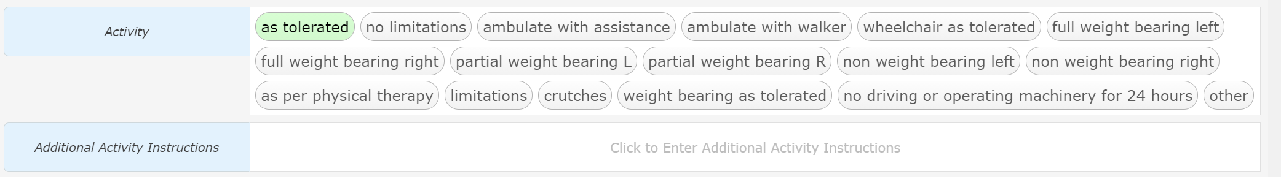
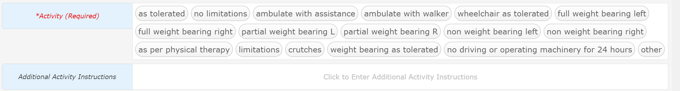
Universal Discharge
Activity (required)
Activity
Activity is a required question
Additional activity instructions allow for more detail to be inserted

Slide 36
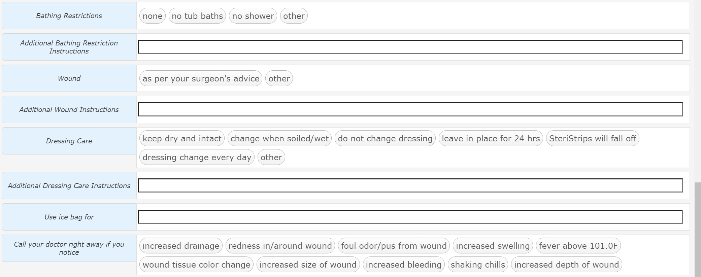
Universal Discharge
Surgical Section
This surgical section allows for Post-Op care to be given with many free text options

Slide 37
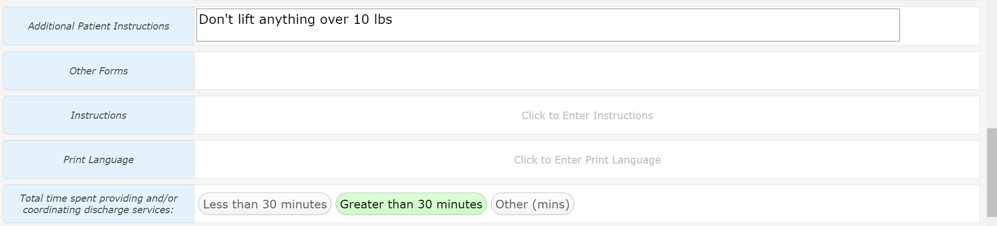
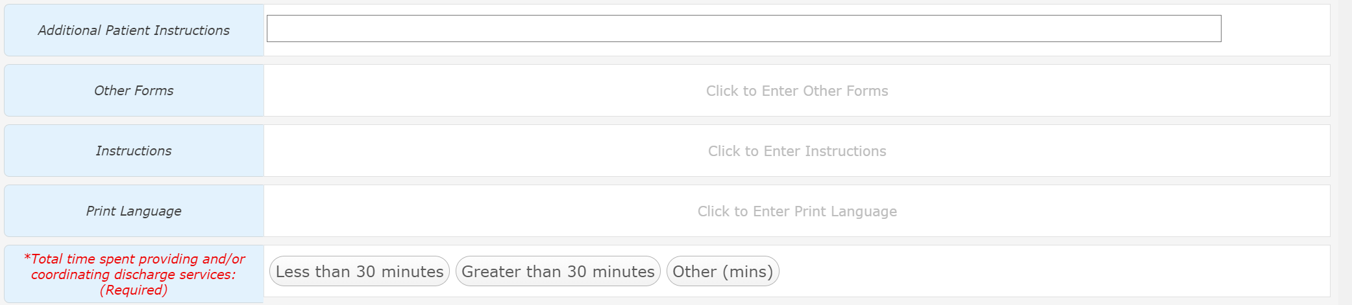
Universal Discharge
The Last Instructions
This section has the last areas for instructions
  Additional Patient Instructions – ANY instructions not covered elsewhere
  Forms – we aren’t using this on inpatient side
  Instructions – Canned text instructions (Discussed next slide)
  Print Language – ONLY the canned text (English/Spanish)
  Total Time – Required – May affect billing (service dependent)

Slide 38
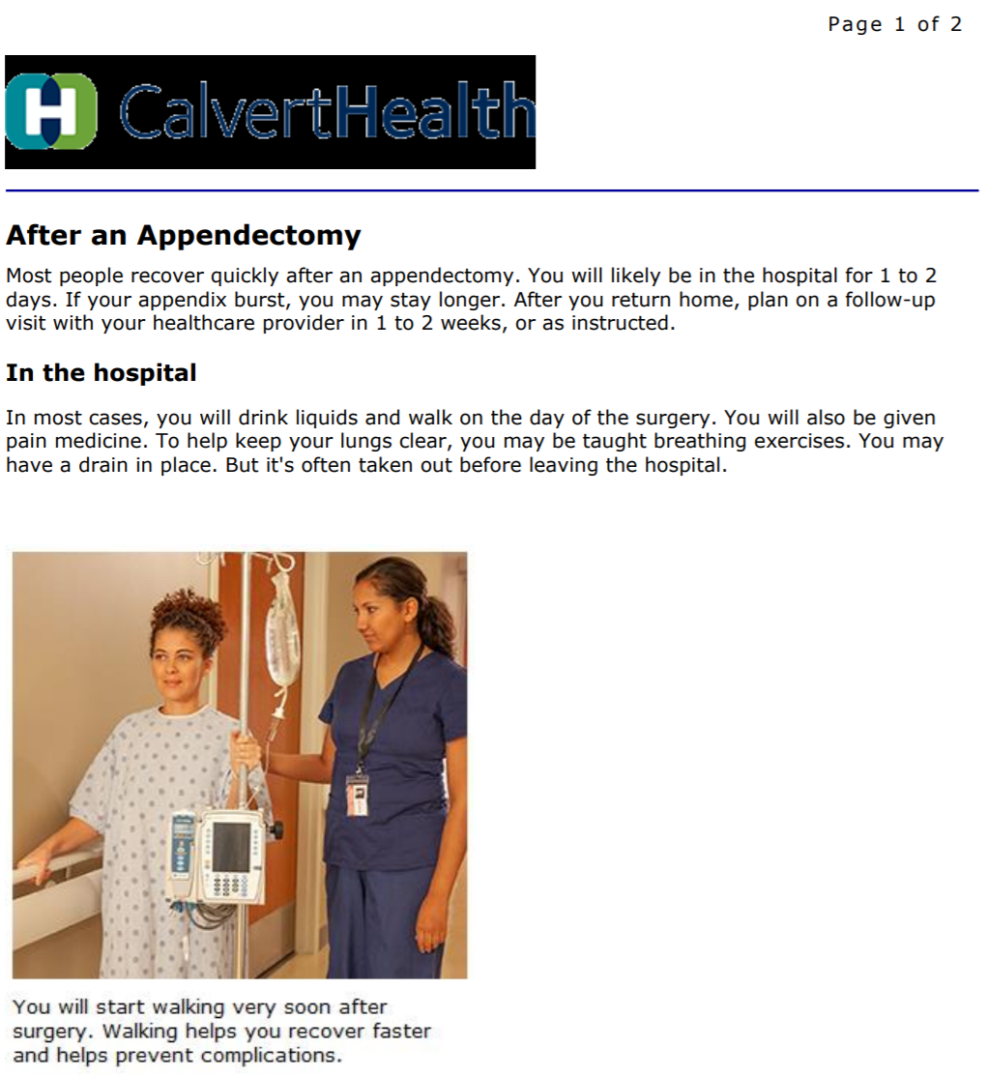


Universal Discharge
Canned Text Instructions
Instructions
Search by diagnosis/key word
Available instructions are listed
Scroll for additional options
Click icon to view instructions (recommended prior to selecting first time)
Click box to select
OK to add when done
Current Problems may be selected from
  This process doesn’t seem to work properly yet
Additional Instructions may be search for
This is a cropped screen shot of part of page 1 for “After an Appendectomy”

Slide 39

Universal Discharge
This section is reserved for future functionality
Ignore this section until instructed to use

Slide 40

Universal Discharge
Discharge Order
Discharge Order
  Click either area to access order
The Discharge Order
  Date/Time can be changed if initiated prior to anticipated Discharge time
  Required “Yes/No” to conditional
  Conditional Criteria required IF “Yes” – Free text
    **Must be assessable by Nurse**
    Will trigger a nursing documentation reflex order

Slide 41
Universal Discharge
Summary
We have reviewed the Inpatient Universal Discharge
  This is the longest and most complex Discharge
  SDS Discharge instructions are more focused and a subset of the Inpatient Universal Discharge

Slide 42







Universal Discharge
ED
Ready for Discharge – Flags the nurse
Specificity may need to be added to generate an ICD-10 Code
Clinical Impression
Click on Blue area to search for alternatives

Slide 43

Universal Discharge
ED
Discharge Date/Time
  Nursing function – This field actually discharges the patient
Instructions
  Suggestions if recommended Clinical Impression selected
Clicking anywhere in this area will allow you to search for additional instructions

Slide 44

Universal Discharge
ED
This section has the same functionality as discussed previously
  The order may be different

Slide 45


Universal Discharge
ED
The ED – Work/School Release form is visible but others are available
Transfer to – Hospital list
  May have to search by name due to list size
  This is a shared field which causes issues when multiple providers are signing Doc
Reason for Transfer – justification for transfer
Accepting provider – Receiving facility

Slide 46

Thank You
You should have been scheduled for 1 on 1 training
Please call (410)535-8260 or email glenn.heaney@calverthealthmed.org if you have questions

